Slide 1
데이터 사이언스 응용
임시 명: 우리 집 어떡해?
방세네조
2017315018 방제호
2017315034 전세종

Slide 2


Motivation

Slide 3
Motivation
-$$$

Slide 4

Motivation

Slide 5


Motivation

Slide 6

Motivation

Slide 7
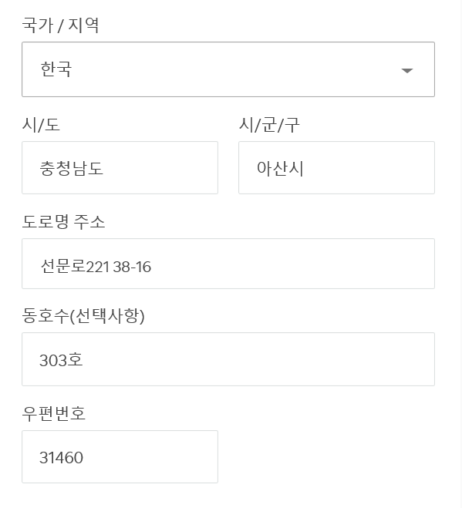


Motivation

Slide 8
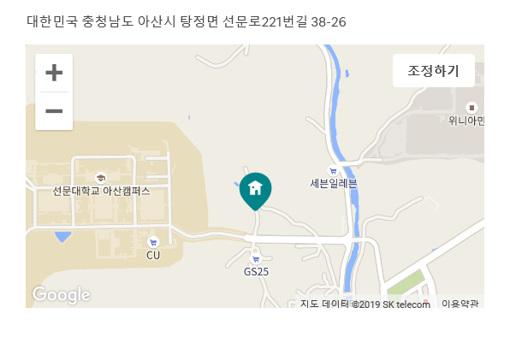
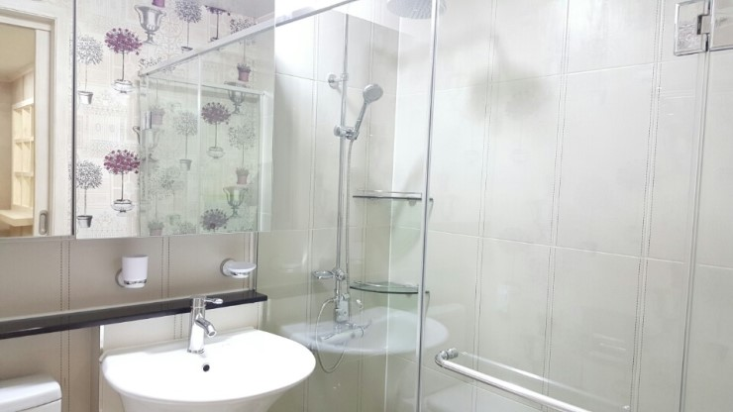
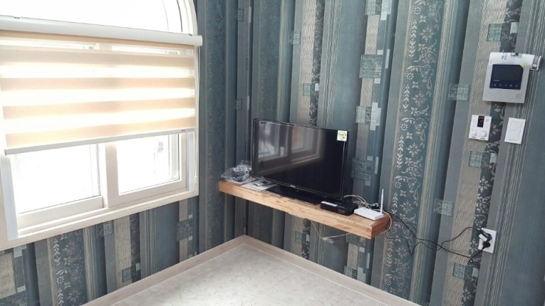
Motivation

Slide 9

Motivation

Slide 10
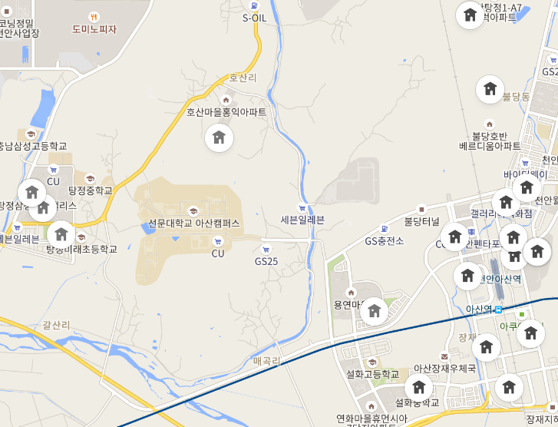
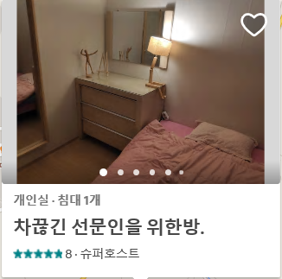
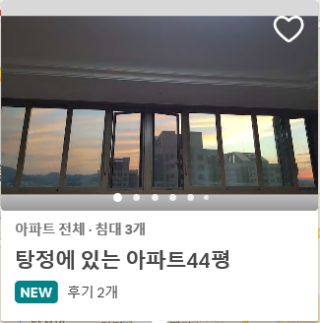

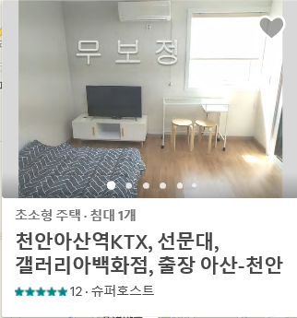
Motivation
?
?
?

Slide 11




Motivation
= 1
$200
= 1
= ..시..동..로

Slide 12
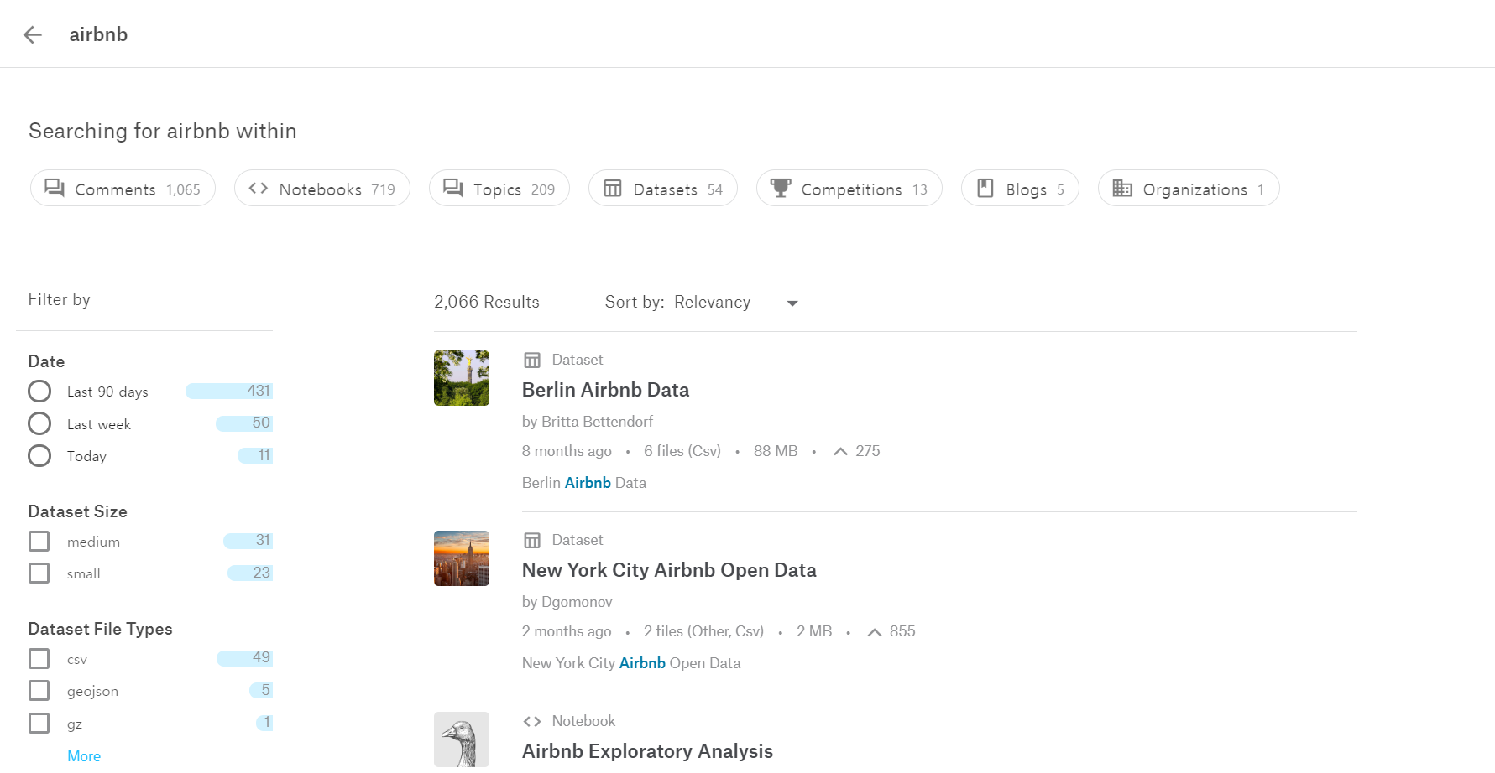
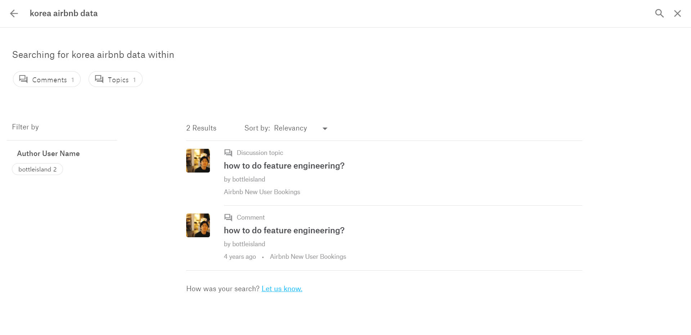
Data

Slide 13

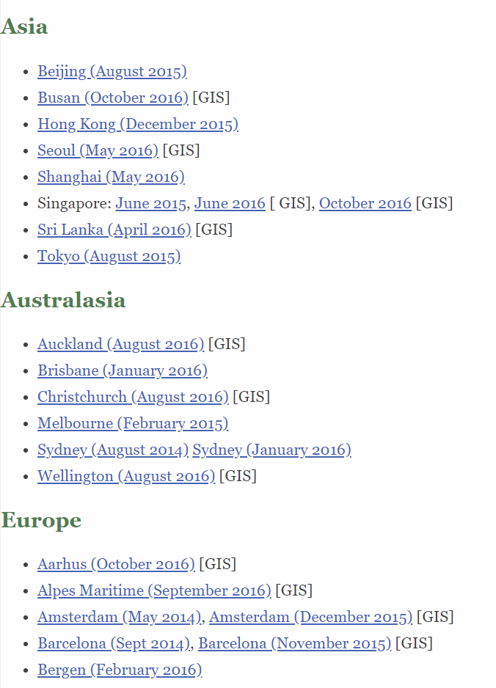
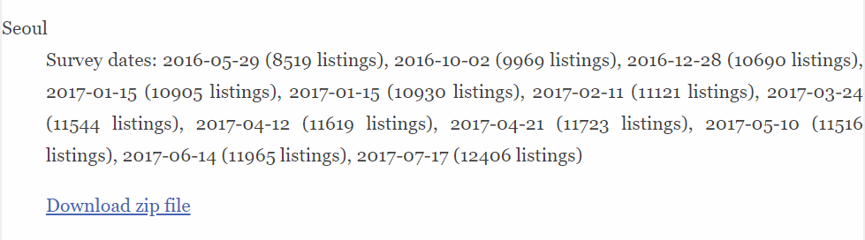
Data

Slide 14
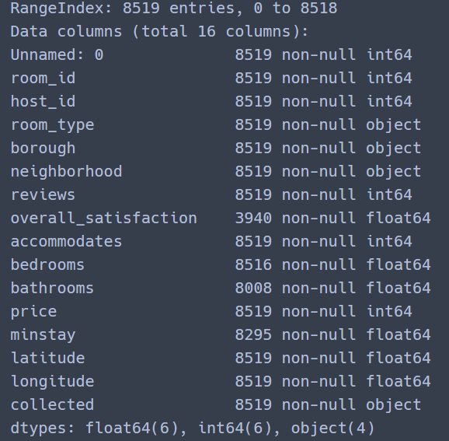
Data information
We dataset 2016-05 Seoul city
Feature total 16 columns
Unnamed : 0 -> csv file data index
Room_id -> room primary key
Host_id -> host primary key
Room_type -> share room, private room, apartment
Borough -> city name
Neighborhood -> Administrative area
Reviews -> number of reviews
Overall_satisfaction -> overall
Accommodates -> number of guests a listing can accommodate
Bedrooms -> number of bedrooms
Bathrooms -> number of bathrooms
Price -> how much
Minstay -> minimum minstay(host selelct)
Latitude
Longitude
Collected -> the date and time that the values were read from the Airbnb web site

Slide 15
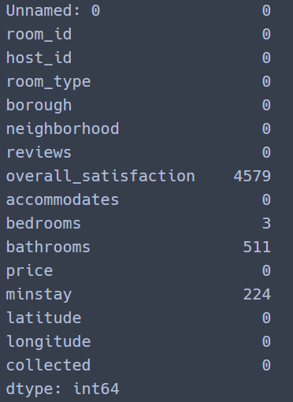
Missing Data

Slide 16
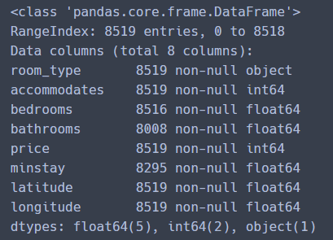
Feature drop

Slide 17
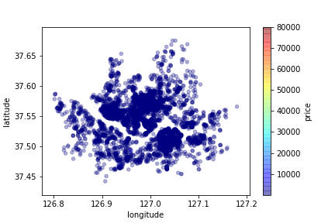
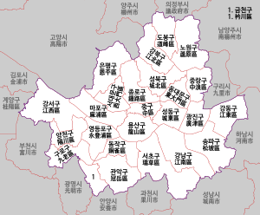
Seoul map

Slide 18
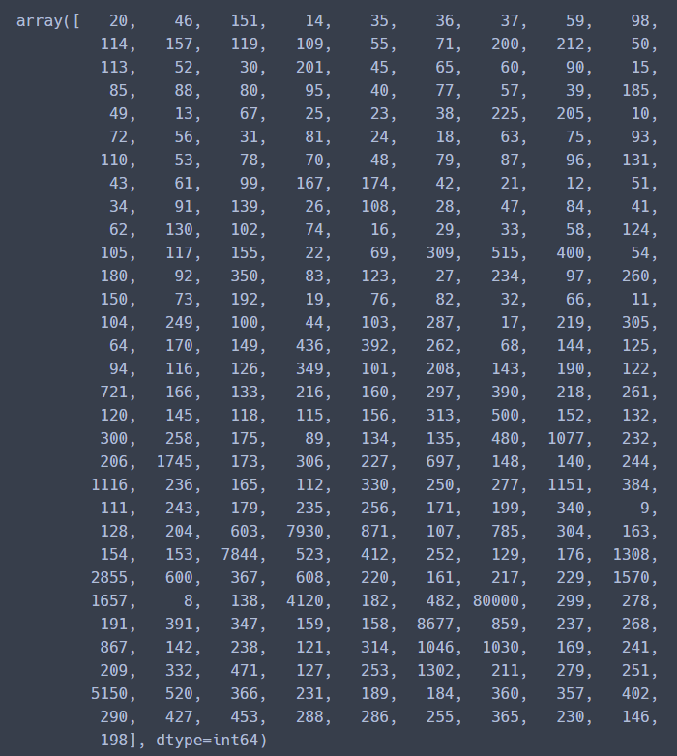
Price info

Slide 19
Price >= 200$
and
Accommodates < 6
Drop!

Slide 20
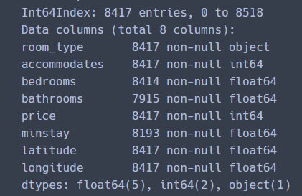
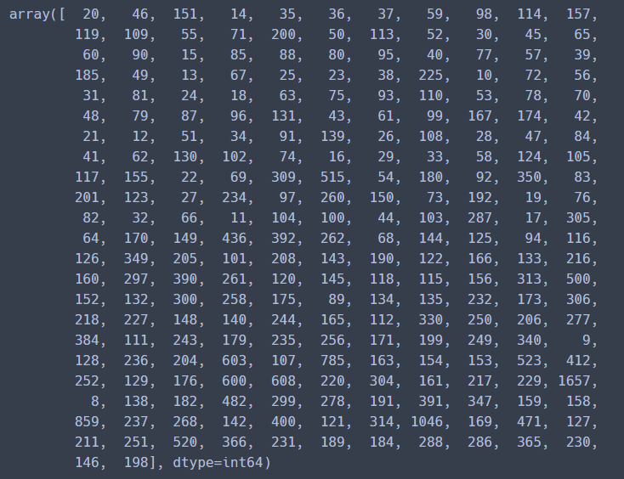
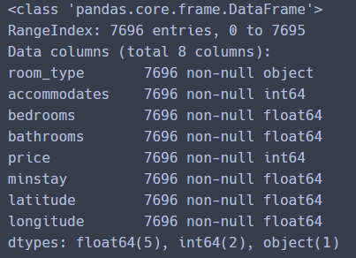
Missing value
price info
Missing value Drop
Categorical data

Slide 21
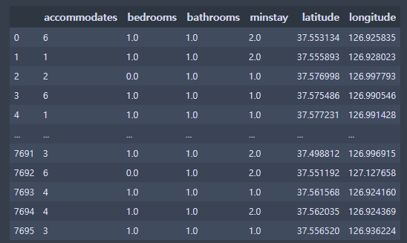


Data Slicing

Slide 22
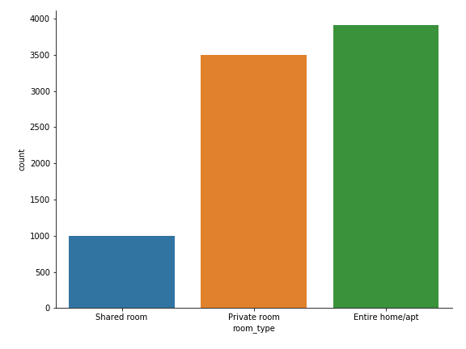
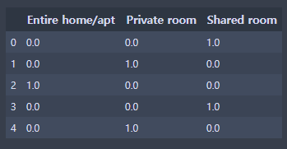
Room_type OneHotEncoder
Room_type bar

Slide 23
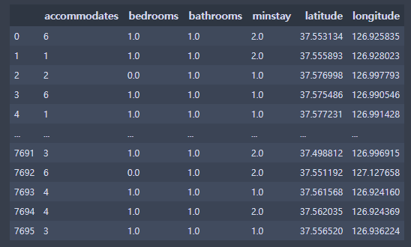
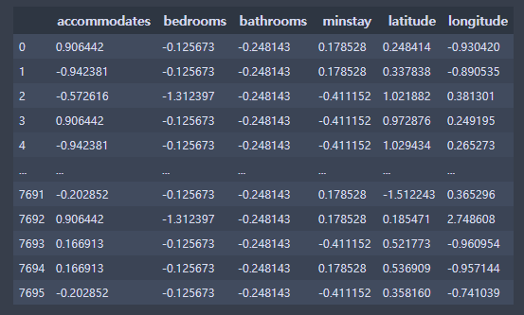
Data Scaler
Standard scaler

Slide 24
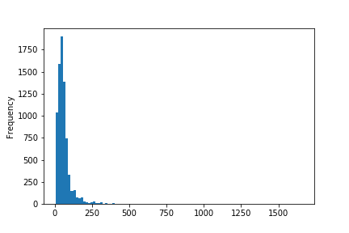
Price histogram
Group | Group_1 | Group_2 | Group_3 | Group_4 | Group_5 | Group_6
price | 0~50$ | 51~100$ | 101~150$ | 151~200$ | 201~500$ | 501~1657$

Slide 25
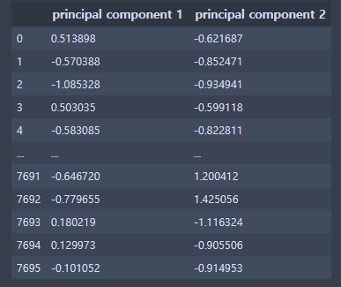
PCA 2Dimension

Slide 26
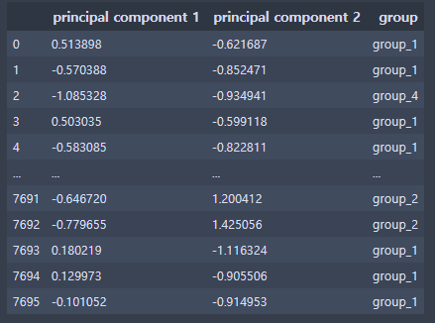
PCA data + group

Slide 27
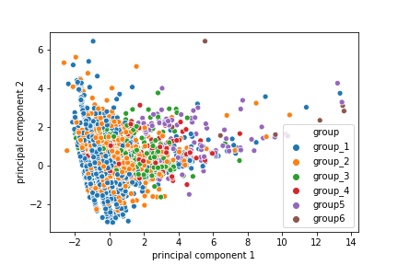
PCA 2D visualization

Slide 28
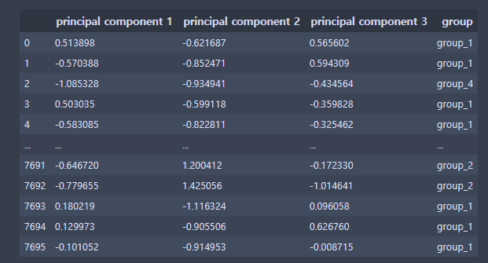
PCA 3Dimension

Slide 29
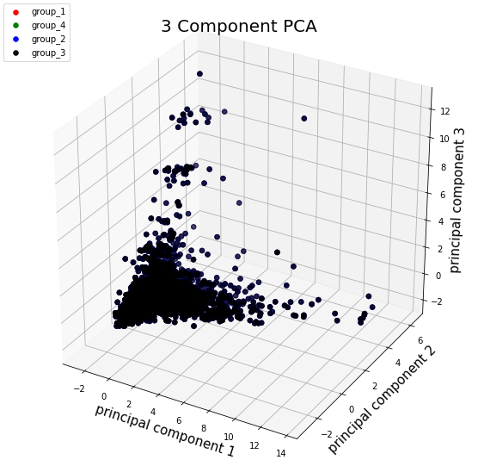
PCA 3D visualization

Slide 30
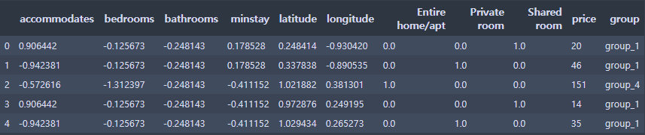
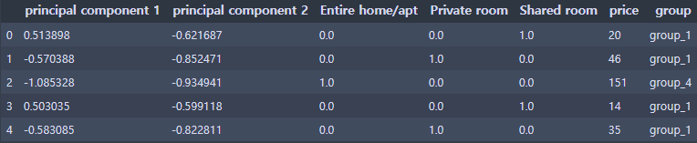
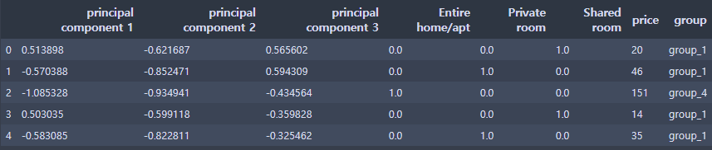
Original Data Concatenate
PCA 2D Data Concatenate
PCA 3D Data Concatenate

Slide 31
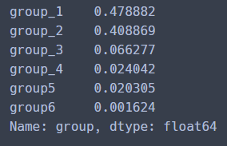
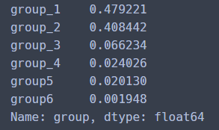
Stratified Shuffle Split (Train : 0.8, Test : 0.2)
Train_data
Test_data

Slide 32
Train and Test data cleaning
Drop Group Column
train_X,test_X Drop price
&
train_y, test_y = price

Slide 33
Default hyperparameter models performance
No PCA
Model | Random Forest | Neural Network | SVM
Train mean square | 15.886858640174635 | 41.26015967357692 | 48.990210993925814
Test mean square | 38.11525660039934 | 35.687984822263736 | 39.991565669217366
PCA 2D
Model | Random Forest | Neural Network | SVM
Train mean square | 18.851336252173947 | 43.48454304828039 | 50.11847075790632
Test mean square | 41.4673861833986 | 36.24433740860674 | 41.621196834954496
PCA 3D
Model | Random Forest | Neural Network | SVM
Train mean square | 17.36318761850783 | 43.18824583078685 | 49.274558661179924
Test mean square | 38.19675574378862 | 36.07539186904657 | 42.0103651402934

Slide 34
Thank you

